Slide 1
Managing Research Data
DAVIS workshop – survival skills series
Notes:
Use the term Data Management Plan?

Slide 2
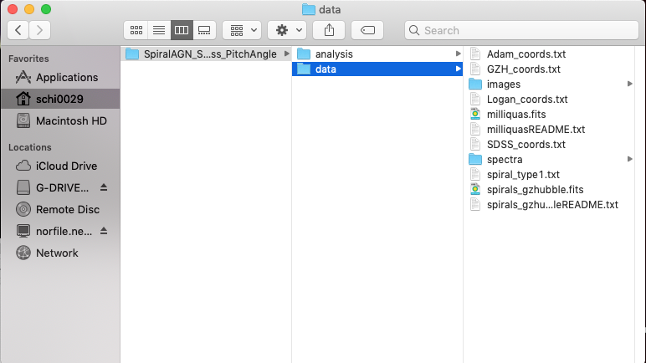
Not an actual slide; will show directory window
Notes:
Handouts option – pass out a worksheet with this same representation, ask groups to discuss for a few minutes

Slide 3
File Naming
Use – or _ or capitalization instead of spaces
this file.docx
ThisFile.docx
this_file.docx
Don’t use special characters like !@#$%^&
Be descriptive!
Is a date appropriate? YYYYMMDDleafcolor.dat
Are there multiple observers? YYYYMMDD_counts_ABS.csv
File extensions are important (.txt, .csv, .exe)
Be consistent – are there guidelines already in place? e.g.
Notes:
The example is a high-level nomenclature
Long file names, nested folders (long path) can cause problems with certain tools like command line
Grey out all except the point you’re discussing

Slide 4
File Organization
new_research_project
data
raw_data
reduced_data
analysis
question1
question2
literature
write_up
Notes:
Organization = you can search and find
Being able to share is secondary
For certain projects, dynamically linking, if Excel is your primary tool interaction with your data

Slide 5
README files
Create README for each file or data set
Write as plain text file
Information to include:
Introductory – describe data (brief), name/institution/contact info Pi/Co-I, dates/locations of data collection, …
Methods – experiment design, links to documentation, instrument info, …
Data – define columns/column headings, units, symbol/value for missing data, …
Sharing/access – licenses, publications w/data, links to publically accessible data, recommended citation, …
https://libraries.ou.edu/content/how-make-readmetxt-file
Notes:
Gray out all points except the one you’re talking about
Exclude text on side for “information to include” search libraries discovery for ”readme file”

Slide 6
Spreadsheet OR Database?
Spreadsheet
Database
Tabulate data
Edited directly
Quickly analyze, make charts (e.g. in Excel)
Relational data
Edited by specific software (multi-user friendly)
Can handle large data sets
Complex searching
Notes:
Spreadsheets are a good place to start
Add comparison to CSV – easy to read, no tabs, imports to most programs, can be connected programming language

Slide 7
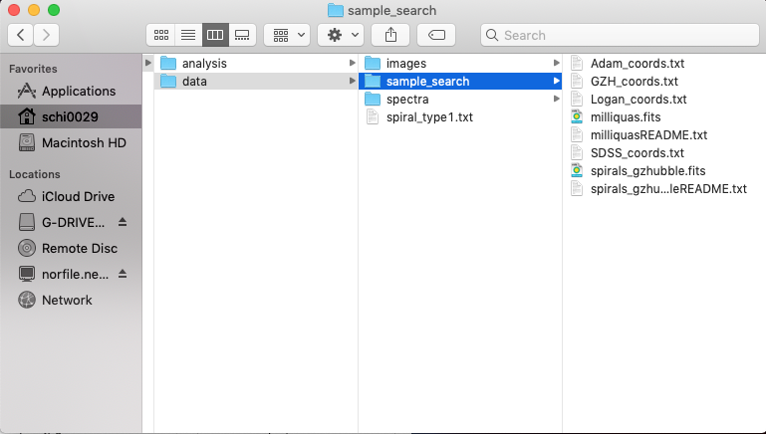
Not an actual slide; will show directory window
Notes:
On worksheet, ask groups to “fix”

Slide 8
Find out more
DAVIS office hours
DAVIS workshops (DMP, DMP tools, OSF, etc.)
https://guides.ou.edu/datamanagement
Mark Laufersweiler, Research Data Specialist

Slide 9
Slide Title
Speaker Name
Title
Contact Information

